Slide 1
Packaging Requirement Instructions
© 2015 Endries International, Inc., a Wolseley Industrial Group company

Slide 2
Carton Dimension & Strength
Dimension of carton depends on how suppliers make the ultimate package. Recommended 405 cubic inches (6.6 liters) for most threaded products.
Suppliers package by cartons with Endries logo.
No carton can be heavier than
15.91 kg (35 lbs) max
Single wall corrugated carton is acceptable.
Carton edge crush strength (ECT) for stacking must be 29 ECT min.
29 ECT provides a burst strength of
79 kg (175 lbs) min.

Slide 3




Label Dimension
Part number / product is stacked on each other vs layered across pallet.
All labels face out
Center carton labels face the sides.
PN:
Lot Number:
Back
Max:4”
Min:2”
Qty:
PN
Lot Number
Qty
Made In Taiwan
PN
Lot Number
1/2-13X2 G5 HHCS ZC WX
Qty
PN
Lot Number
PN
Lot Number
Qty
Qty
PN
Lot Number
Max:6”
Min:4”
PN
Qty
PN
Lot Number
Lot Number
Qty
PN
Qty
PN
Lot Number
Qty
Lot Number
PN
Lot Number
Qty
PN
Lot Number
Qty
PN
Qty
PN
Lot Number
Qty
Lot Number
Qty
PN
PN
Lot Number
Qty
Lot Number
PN
Lot Number
Qty
PN
Lot Number
Qty
Qty
Endries requires that label has to meet length and width limit.
And, 3 of 9 is the only permitted symbology for barcode.
Sample label to be submitted for Endries approval
PN
Lot Number
PN
Qty
PN
Lot Number
Qty
Lot Number
PN
Lot Number
Qty
Qty
PN
Qty
Lot Number
Side
PN
Lot Number
PN
Lot Number
Qty
Qty
Front

Slide 4


Unacceptable Label
Following labels tell bad demonstrations leading to failure receiving:
A. It causes error when 2 barcodes are scanned in one time.
PN:
Lot Number:
Qty:
B. Lot number which can not be traceable is prohibited.
For example: Below Lot number will never change in any case. It is not allowed.
PN:
Lot Number:
Qty:

Slide 5
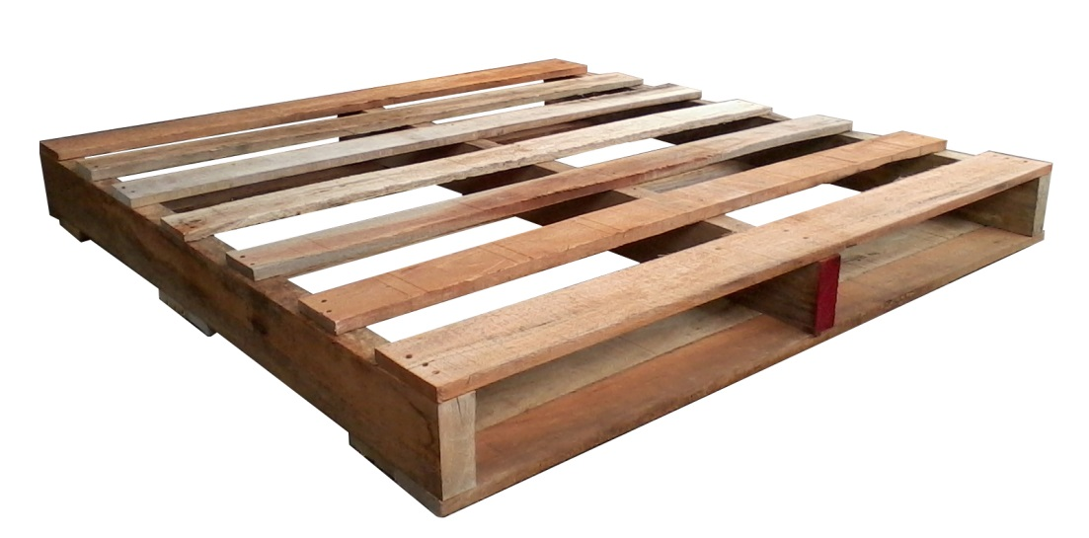
Pallet Specification
An accepted pallet should be:
Free from splint
Free from Mold
Free from Moisture
Free from any kind of seeds or spawns
Free from dirt patch
Free from cracks
Not buckling
Heat Treated or fumigated to IPPC Standards
Endries requires two way pallets.
Front View
Side View

Slide 6
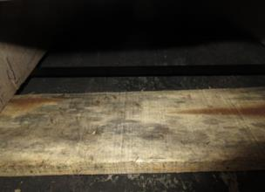
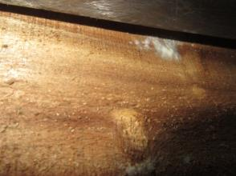
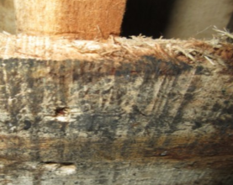
Unacceptable Pallet
Dirt Patch / Mold are not accepted
Mold
Dirty
Sawdust

Slide 7
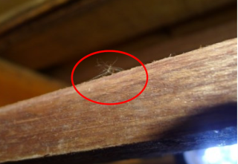
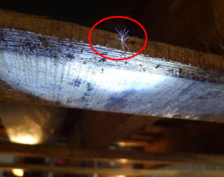
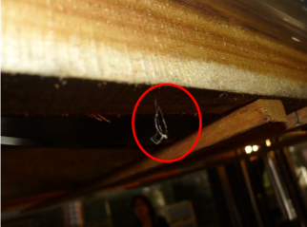
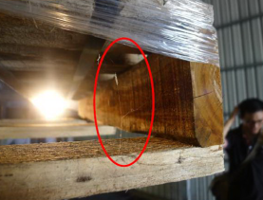
Unacceptable Pallet
Any kind of Seed or Spawn is not accepted
Seed is not accepted.
Seed is not accepted.
Spider
Pests/Insect/Spawn is not accepted.
Spider’s Silk is not accepted.

Slide 8
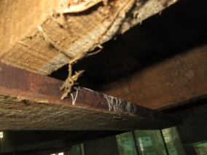

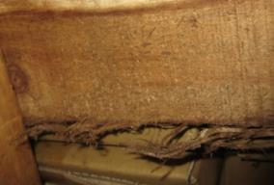
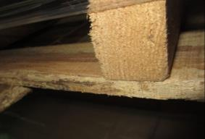
Unacceptable Pallet
Splint is not accepted

Slide 9
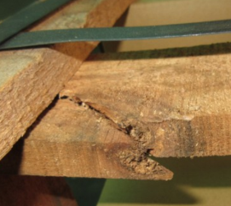
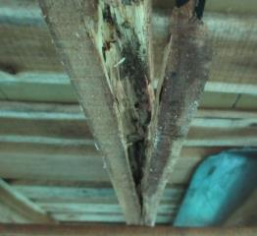
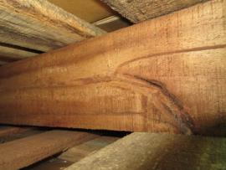
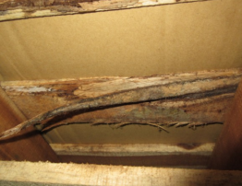
Unacceptable Pallet
Rupture / Crack are not accepted

Slide 10
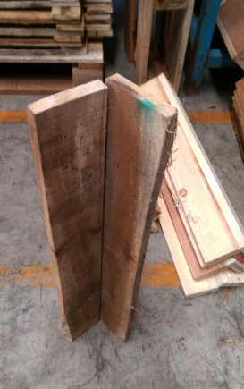
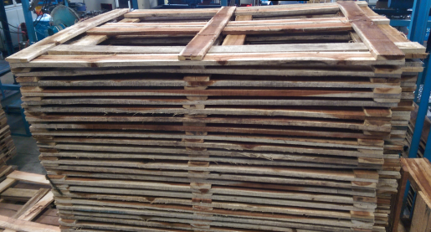
Suggested Packing Process
At first: Please purchase cap and corner bars with pallet supplier.
Second Option: Supplier can make them by self if it is cost-effective.
Note: Endries understands that nails are needed in making caps and bars.

Slide 11
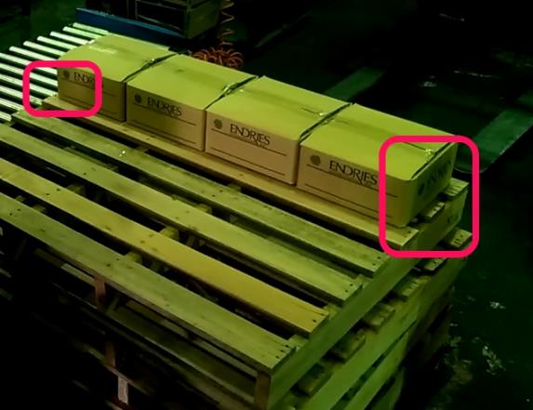
Suggested Packing Process
1. Cartons are loaded to pallet as Endries’ requirement.
Tip: Leave space for corner bars.

Slide 12
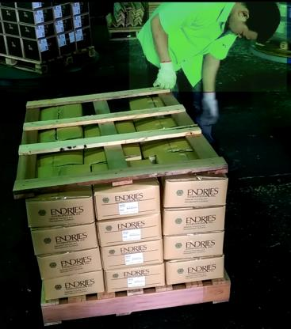
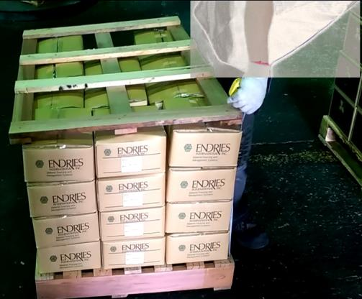
Suggested Packing Process
2. Cap and corner bars are settled after loading cartons
Tip: Please confirm dimension before tightening up.

Slide 13
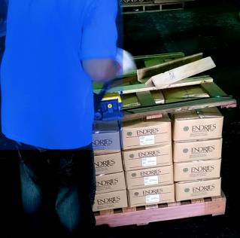
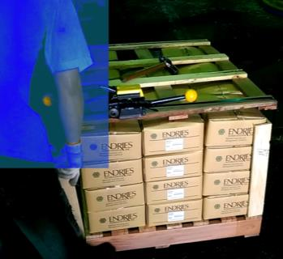
Suggested Packing Process
3. Pallet is tightened up
Nylon banding is preferred instead of metal
- Environmentally conscious
- Metal is harder to handle and dispose of
Tightening up
Corner bars are settled during process.

Slide 14
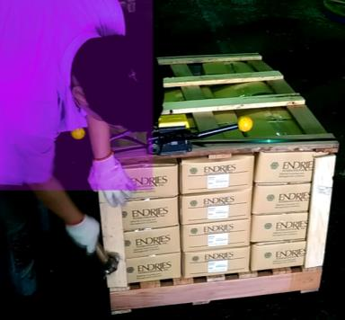
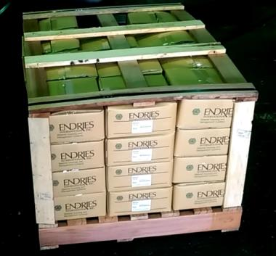
Suggested Packing Process
4. Pallet is tightened up
Before completely tightening, operator can adjust corner bar with hammer
No nail is used in this step

Slide 15
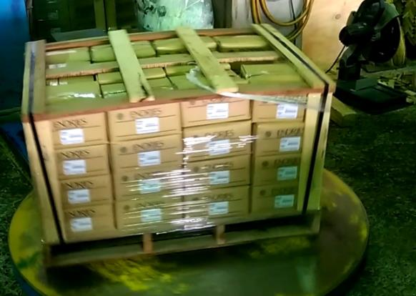
Suggested Packing Process
5. Encapsulating

Slide 16
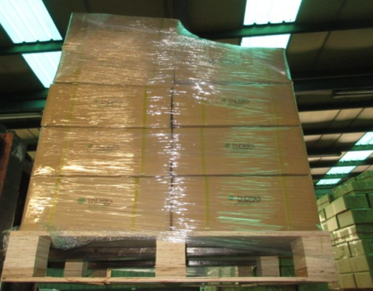
Acceptable Packed Pallet
Bulk pallet is accepted
Encapsulation is needed for bulk pallet that corner bars and caps can not be applied to
Weight limit on each carton and Pallet dimension are still valid to bulk pallet
No pallet can be heavier than 1133 kg(2500 lbs) max
No pallet can be taller than 68.58 cm(27”) max
PN
Lot Number
PN
Qty
Qty
Lot Number
PN
Lot Number
PN
Lot Number
Qty
Qty
PN
Lot Number
PN
Qty
PN
Lot Number
Lot Number
Qty
PN
Qty
PN
Lot Number
Qty
Lot Number
PN
Lot Number
Qty
PN
Lot Number
Qty
PN
Qty
PN
Lot Number
Qty
Lot Number
Qty
Max:
27”
PN
PN
Lot Number
Qty
Lot Number
PN
Lot Number
Qty
PN
Lot Number
Qty
PN
Qty
Lot Number
PN
Qty
PN
Lot Number
Qty
Lot Number
PN
Lot Number
Qty
Qty
PN
Lot Number
PN
Lot Number
PN
Lot Number
Qty
Qty
Qty
Max: 44” or 48”
Max: 40” or 42”

Slide 17
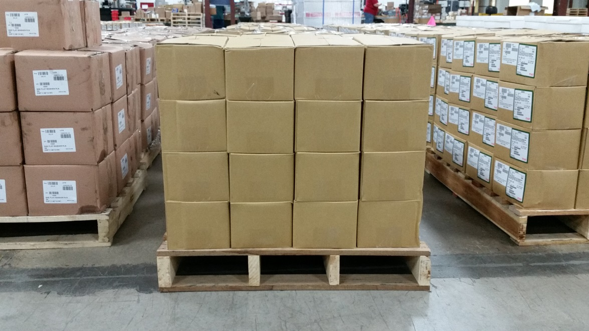
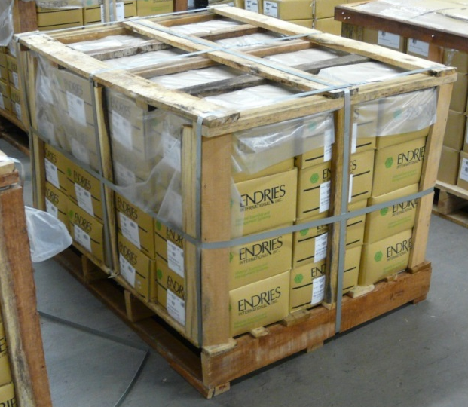
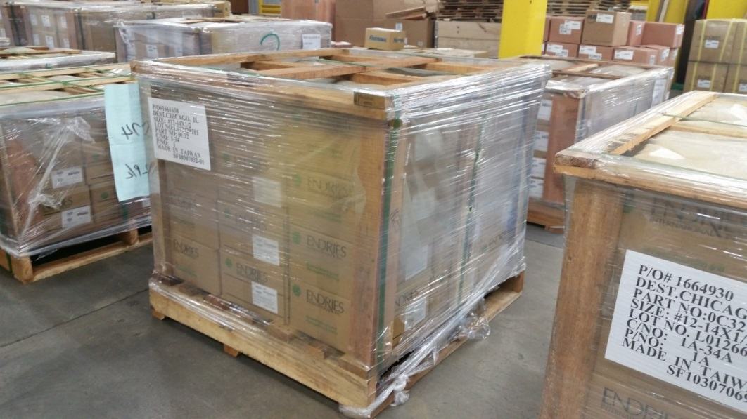
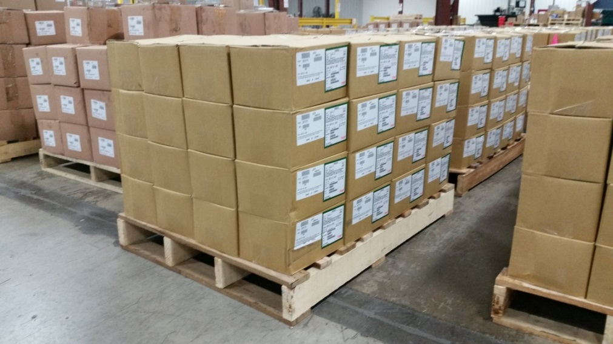
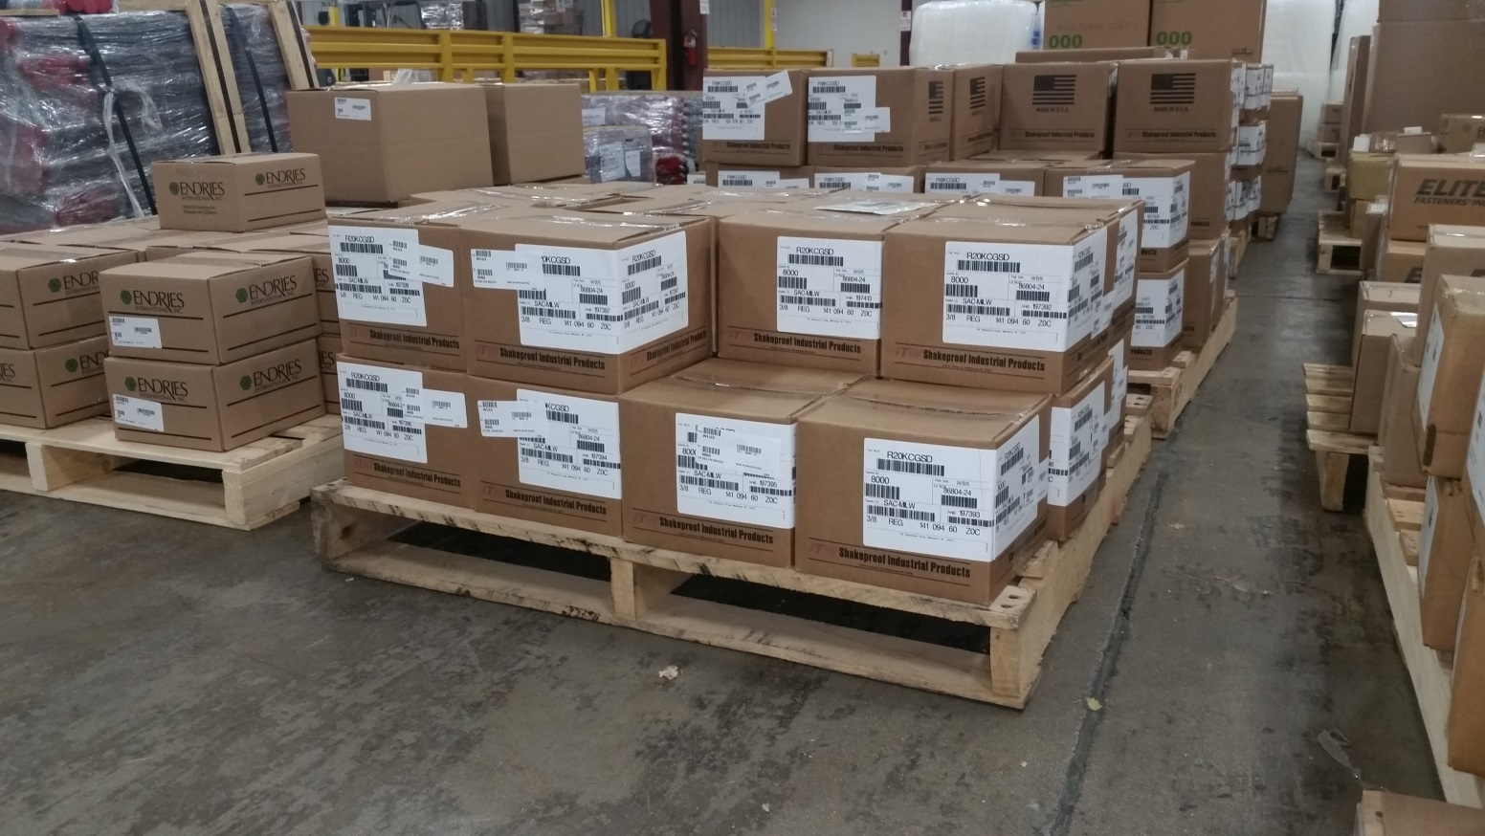
Acceptable Pallet Examples
12 ½”
9”
12 ½”
17 ¾”
17 ¾”
3 1/2”

Slide 18
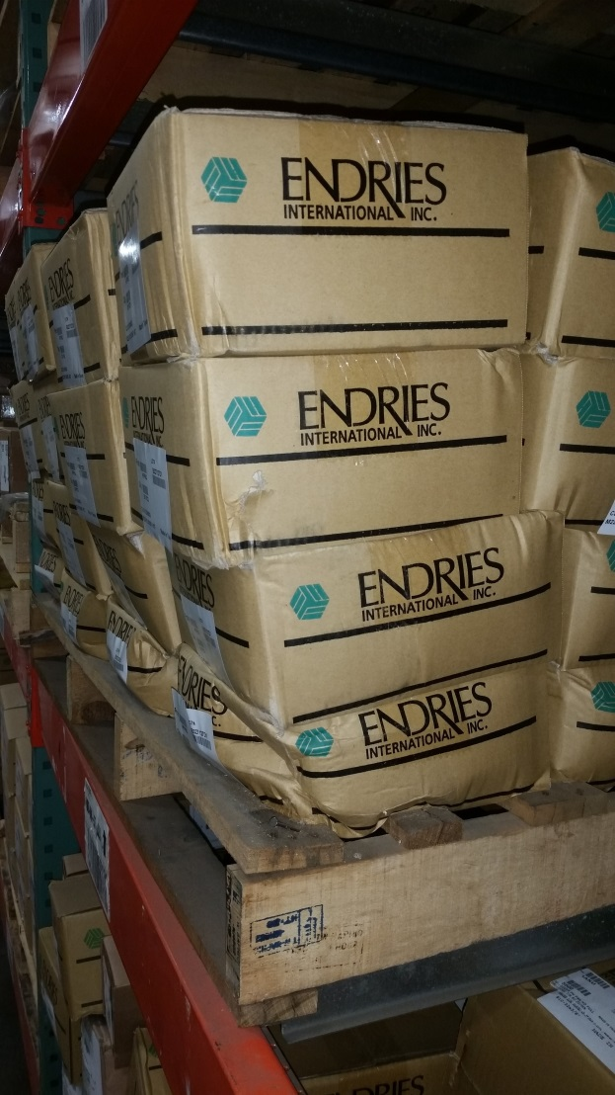
Unacceptable Packed Pallet
Carton edge strength must withstand stacking
Weak carton edges cause people injury. Outside stacks of cartons or top cartons can fall off pallet in storage.

Slide 19
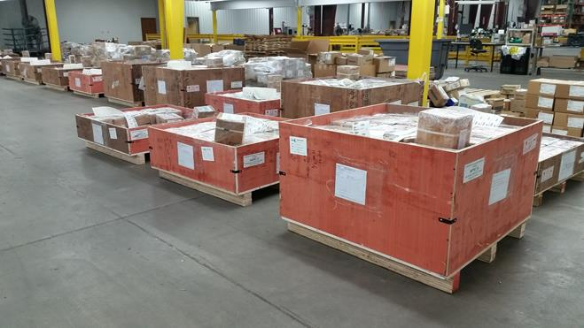
Unacceptable Pallet
Some products require crates such as pulleys
Supplier PO to state “Contact Endries for crate construction and dimensions”
This is allowed only in special cases and with prior approval

Slide 20
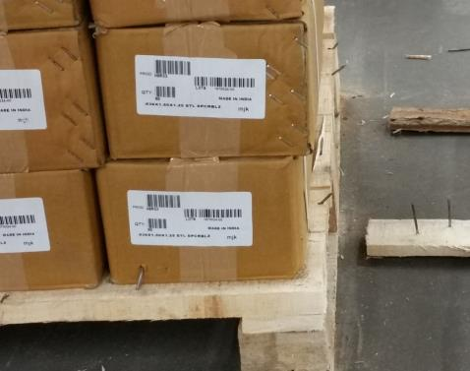
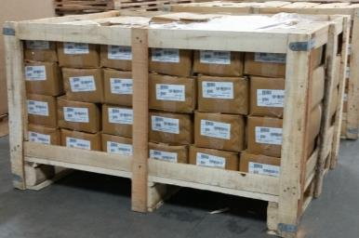
Unacceptable Pallet
No block style pallets allowed.
No nail is used during packing. It would cause people injury.
No extra metal banding on corners
After Uncrating

